Slide 1
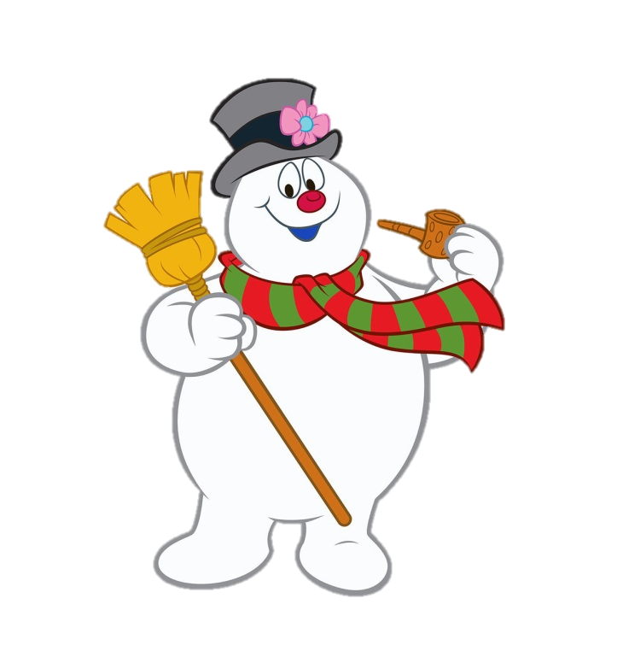
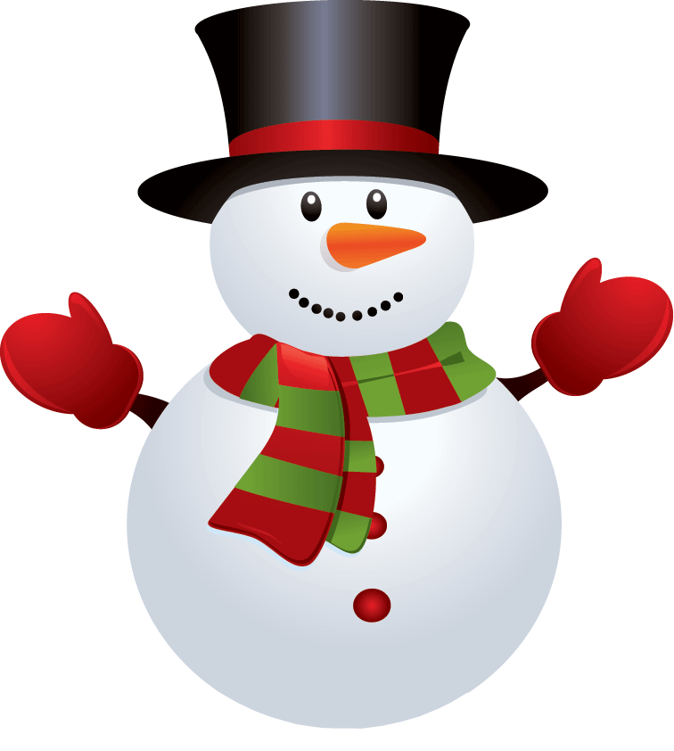
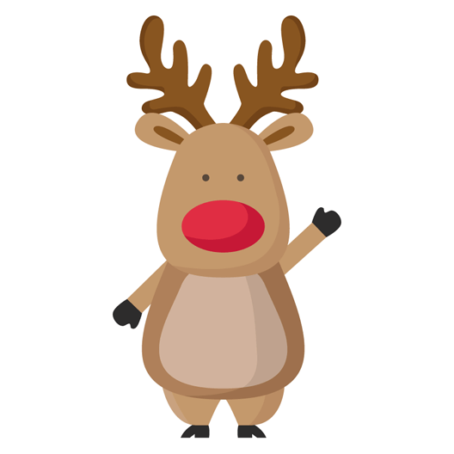
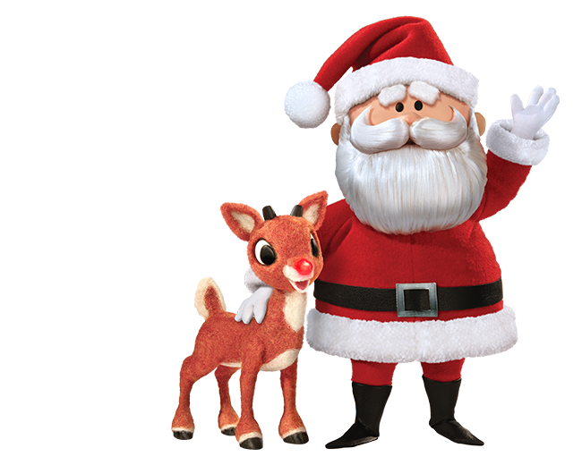
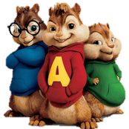
HOLIDAY SING-A-LONG

Slide 2
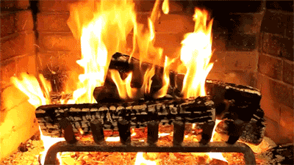

Slide 4
I don't want a lot for Christmas
There's just one thing I need
I don't care about the presents
Underneath the Christmas tree

Slide 5
I just want you for my own
More than you could ever know
Make my wish come true
All I want for Christmas
Is you

Slide 6
I don't want a lot for Christmas
There is just one thing I need
I don't care about the presents
Underneath the Christmas tree

Slide 7
I don't need to hang my stocking
There upon the fireplace
Santa Claus won't
make me happy
With a toy on Christmas day

Slide 8
I just want you for my own
More than you could ever know
Make my wish come true
All I want for Christmas is you
You baby

Slide 9
Oh, I won't ask for much this Christmas
I won't even wish for snow
I'm just gonna keep on waiting
Underneath the mistletoe

Slide 10
I won't make a list and send it
To the North Pole for Saint Nick
I won't even stay awake to
Hear those magic reindeer click

Slide 11
'Cause I just want
you here tonight
Holding on to me so tight
What more can I do
Baby all I want
for Christmas is you
You

Slide 12
All the lights are shining
So brightly everywhere
And the sound of children's
Laughter fills the air

Slide 13
And everyone is singing
I hear those sleigh bells ringing
Santa won't you bring
me the one I really need
Won't you please bring my baby to me

Slide 14
Oh I just want him for my own
More than you could ever know
Make my wish come true
Baby all I want for Christmas is you

Slide 15
All I want for Christmas is you baby
All I want for Christmas is you baby

Slide 17
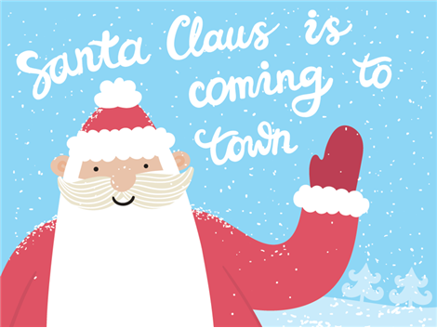
We can hardly
stand the wait
Please Christmas,
don't be late

Slide 18
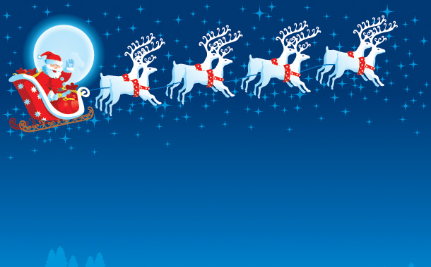
You better watch out
You better not cry
You better not pout
I'm telling you why

Slide 19
Santa Claus is comin' to town
Santa Claus is comin' to town
Santa Claus is comin' to town

Slide 20
He's making a list
He's checking it twice
He's gonna find out
Who's naughty or nice

Slide 21
Santa Claus is comin' to town
Santa Claus is comin' to town
Santa Claus is comin' to town

Slide 22
He sees you when you're sleeping
He knows when you're awake
He knows if you've
been bad or good
So be good for goodness sake

Slide 23
So you better watch out
You better not cry
You better not pout
I'm telling you why

Slide 24
Santa Claus is comin' to town
Santa Claus is comin' to town
Santa Claus is comin' to town

Slide 25
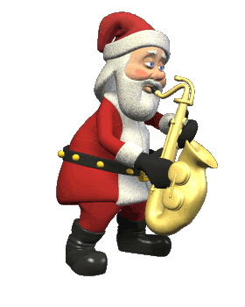

Slide 26
The kids in girl and boyland
Will have a jubilee
They're gonna build a toyland
All around the Christmas tree

Slide 27
So you better watch out
You better not cry
You better not pout
I'm telling you why

Slide 28
Santa Claus is comin' to town
Santa Claus is comin' to town

Slide 29
Santa Claus is comin'
Santa Claus is comin'
Santa Claus is comin'
To town

Slide 32
Feliz Navidad
Feliz Navidad
Feliz Navidad
Prospero Ano y Felicidad.

Slide 33
Feliz Navidad
Feliz Navidad
Feliz Navidad
Prospero Ano y Felicidad.

Slide 34
I wanna wish you
a Merry Christmas
I wanna wish you
a Merry Christmas

Slide 35
I wanna wish you
a Merry Christmas
From the bottom of my heart.

Slide 36
I wanna wish you
a Merry Christmas
I wanna wish you
a Merry Christmas

Slide 37
I wanna wish you
a Merry Christmas
From the bottom of my heart.

Slide 38
Feliz Navidad
Feliz Navidad
Feliz Navidad
Prospero Ano y Felicidad.

Slide 39
Feliz Navidad
Feliz Navidad
Feliz Navidad
Prospero Ano y Felicidad.

Slide 40
I wanna wish you
a Merry Christmas
I wanna wish you
a Merry Christmas

Slide 41
I wanna wish you
a Merry Christmas
From the bottom of my heart.

Slide 42
I wanna wish you
a Merry Christmas
I wanna wish you
a Merry Christmas

Slide 43
I wanna wish you
a Merry Christmas
From the bottom of my heart.

Slide 44
Feliz Navidad
Feliz Navidad
Feliz Navidad
Prospero Ano y Felicidad.

Slide 45
Feliz Navidad
Feliz Navidad
Feliz Navidad
Prospero Ano y Felicidad.

Slide 46
I wanna wish you
a Merry Christmas
I wanna wish you
a Merry Christmas

Slide 47
I wanna wish you
a Merry Christmas
From the bottom of my heart.

