Slide 1
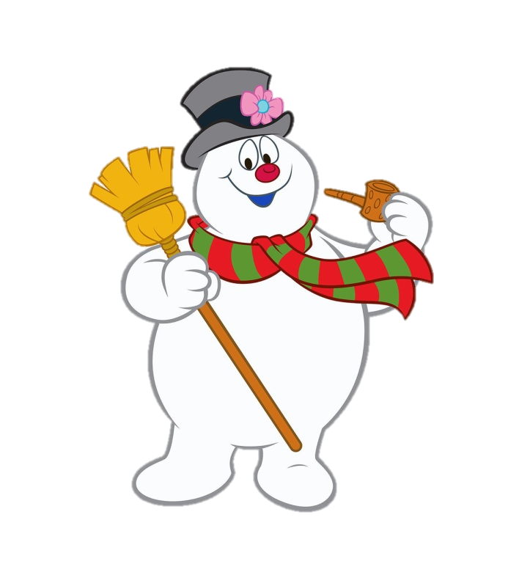
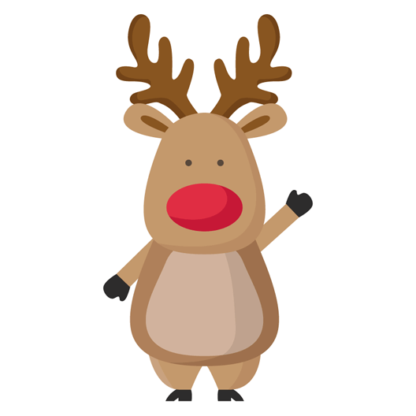
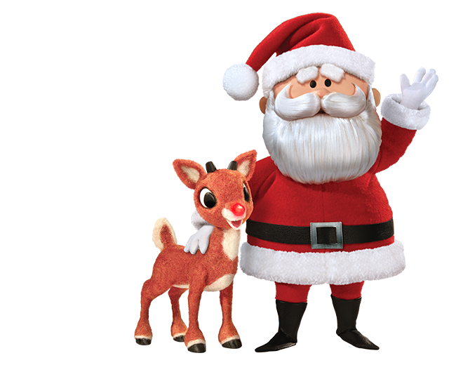
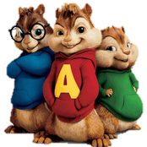
HOLIDAY SING-A-LONG

Slide 2
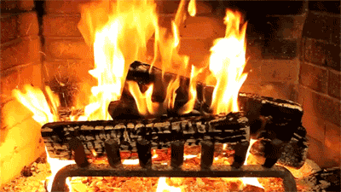

Slide 4
Sleigh bells ring
are you listening
in the lane
snow is glistening

Slide 5
A beautiful sight
we're happy tonight
walking in a
winter wonderland

Slide 6
Gone away is the bluebird
here to stay is a new bird
He sings a love song
as we go along
walking in a winter wonderland

Slide 7
In the meadow
we can build a snowman
Then pretend that
he is Parson Brown

Slide 8
He'll say: Are you married?
we'll say: No man
But you can do the job
when you're in town

Slide 9
Later on
we'll conspire
as we dream by the fire

Slide 10
To face unafraid
the plans that we've made
walking in a winter wonderland

Slide 11
Sleigh bells ring
are you listening
in the lane
snow is glistening

Slide 12
A beautiful sight
we're happy tonight
walking in a
winter wonderland

Slide 13
Gone away is the bluebird
here to stay is a new bird
He sings a love song
as we go along
walking in a winter wonderland

Slide 14
In the meadow
we can build a snowman
Then pretend that
he is Parson Brown

Slide 15
He'll say: Are you married?
we'll say: No man
But you can do the job
when you're in town

Slide 16
Later on
we'll conspire
as we dream by the fire

Slide 17
To face unafraid
the plans that we've made
walking in a winter wonderland

Slide 19
To face unafraid
the plans that we've made
walking in a winter wonderland

Slide 20
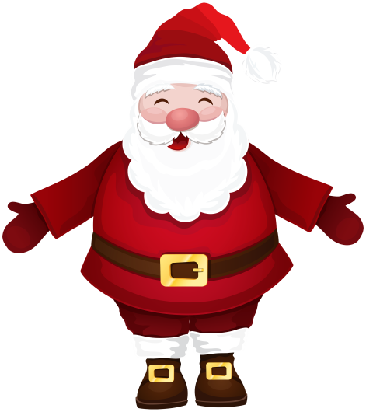
Here comes Santa Claus,
here comes Santa Claus,
right down Santa Claus Lane

Slide 21
Vixen and Blitzen and all his reindeers pulling on the reins

Slide 22
Bells are ringing, children singing, all is merry and bright

Slide 23
So hang your stockings
and say your prayers,
'cause Santa Claus
comes tonight

Slide 24
Here comes Santa Claus,
here comes Santa Claus,
right down Santa Claus Lane

Slide 25
He's got a bag
that's filled with toys
for boys and girls again

Slide 26
Hear those
sleigh bells jingle jangle,
oh what a beautiful sight

Slide 27
So jump in bed
and cover your head,
'cause Santa Claus
comes tonight

Slide 28
Here comes Santa Claus,
here comes Santa Claus,
right down Santa Claus Lane

Slide 29
He doesn't care
if you're rich or poor,
he loves you just the same

Slide 30
Santa Claus knows
we're all God's children,
and that makes everything right

Slide 31
So fill your hearts
with Christmas cheer,
'cause Santa Claus
comes tonight

Slide 32
Here comes Santa Claus,
Here comes Santa Claus,
Here comes Santa Claus,
Here comes Santa Claus
Here comes Santa Claus,
Here comes Santa Claus
Here comes Santa Claus Here comes Santa Claus

Slide 34
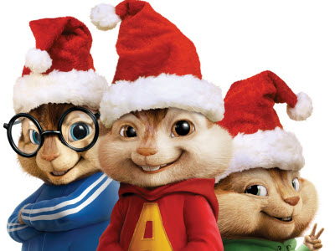
Christmas Don’t Be Late

Slide 35
Christmas, Christmas
time is near
Time for toys
and time for cheer

Slide 36
We've been good,
but it won’t last
Hurry Christmas,
hurry fast

Slide 37
Want a plane
that loops the loop
Me, I want a hula hoop

Slide 38
We can hardly
stand the wait
Please Christmas,
don't be late

Slide 39
Christmas, Christmas
time is near
Time for toys
and time for cheer

Slide 40
We've been good,
but it won’t last
Hurry Christmas,
hurry fast

Slide 41
Want a plane
that loops the loop
Me, I want a hula hoop

Slide 42
We can hardly
stand the wait
Please Christmas,
don't be late

Slide 43
We can hardly
stand the wait
Please Christmas,
don't be late

