Slide 1
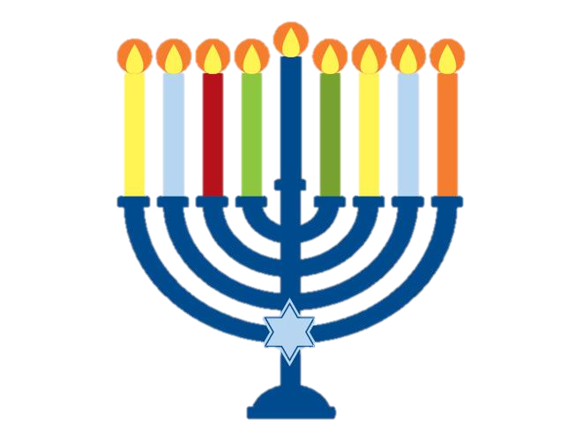
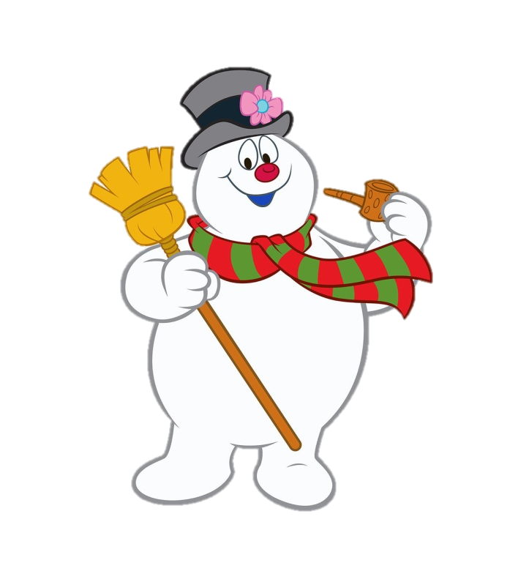
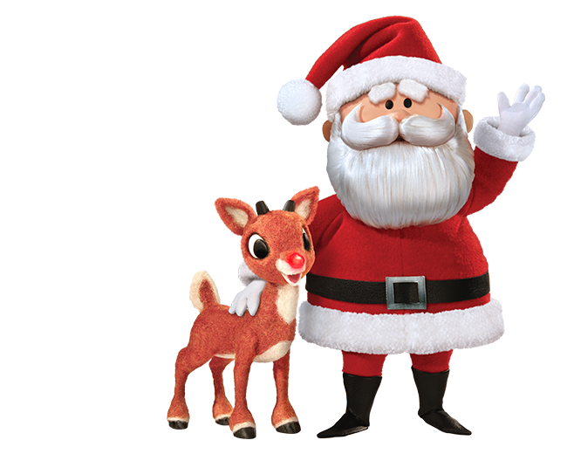
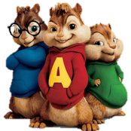
HOLIDAY SING-A-LONG

Slide 2
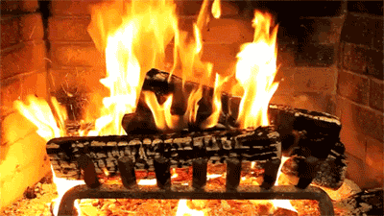

Slide 3
Jingle bells
Jingle bells
Jingle all the way
Oh, what fun
It is to ride
In a one-horse open sleigh

Slide 4
O Christmas tree,
O Christmas tree
Your leaves are so unchanging
O Christmas tree,
O Christmas tree
Your leaves are so unchanging

Slide 5
Not only green when
Summer’s here
But also when it’s cold and drear
O Christmas tree,
O Christmas tree
Your leaves are so unchanging

Slide 6
O Christmas tree,
O Christmas tree
Much pleasure you do give me
O Christmas tree,
O Christmas tree
Much pleasure you do give me

Slide 7
How often has
the Christmas tree
Given me the greatest glee
O Christmas tree,
O Christmas tree
Much pleasure you do give me

Slide 8
From top to bottom
You’re so bright
There’s only splendor for the sight
O Christmas tree,
O Christmas tree
Your lights are shining brightly

Slide 9
O Christmas tree,
O Christmas tree
Your lights are shining brightly

Slide 11
Chanukah, Oh, Chanukah

Slide 12
Chanukah, Oh, Chanukah
Come light the menorah
Let's have a party
We'll all dance the hora

Slide 13
Gather round the table,
we'll give you a treat
Sevivon to play with
and levivot to eat

Slide 14
And while we are dancing
The candles are burning bright

Slide 15
One for each night,
they shed a sweet light
To remind us of days long ago

Slide 17
Oh, dreidel, dreidel, dreidel
I made it out of clay
Oh, dreidel, dreidel, dreidel
Now dreidel I shall play.

Slide 18
Deck the halls
with boughs of holly
Fa la la la la la la la la

Slide 19
'Tis the season to be jolly
Fa la la la la la la la la

Slide 20
Don we now our gay apparel
Fa la la la la la la la la

Slide 21
Troll the ancient yuletide carol
Fa la la la la la la la la

Slide 22
See the blazing yule before us
Fa la la la la la la la la

Slide 23
Strike the harp
and join the chorus
Fa la la la la la la la la

Slide 24
Follow me in merry measure
Fa la la la la la la la la

Slide 25
While I tell of yuletide treasure
Fa la la la la la la la la

Slide 26
Sing we joyous all together
Fa la la la la la la la la

Slide 27
Heedless of the
wind and weather

Slide 28
Fa la la la la la la la la
La la la la la la la la
La la la la la
La la la

